Slide 1



Natural language processing to capture person-first or identity-first language
Notes:
I wondered about giving ESHG some credit, but not sure

Slide 2
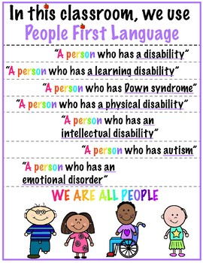
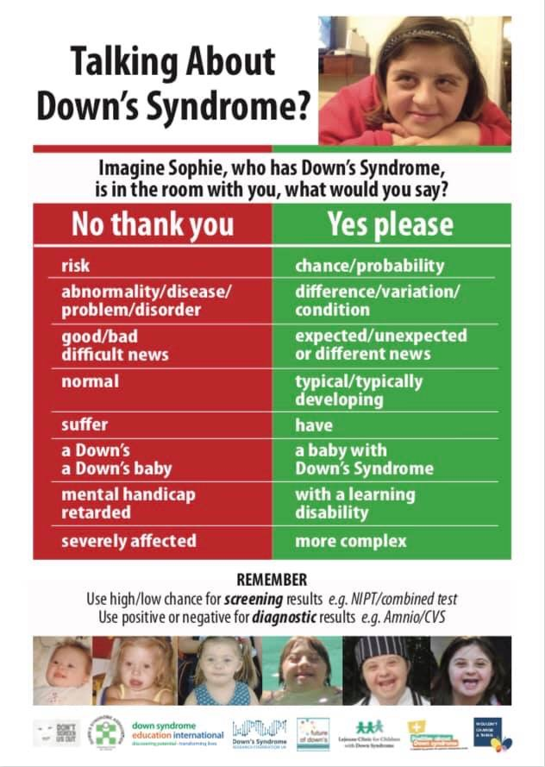
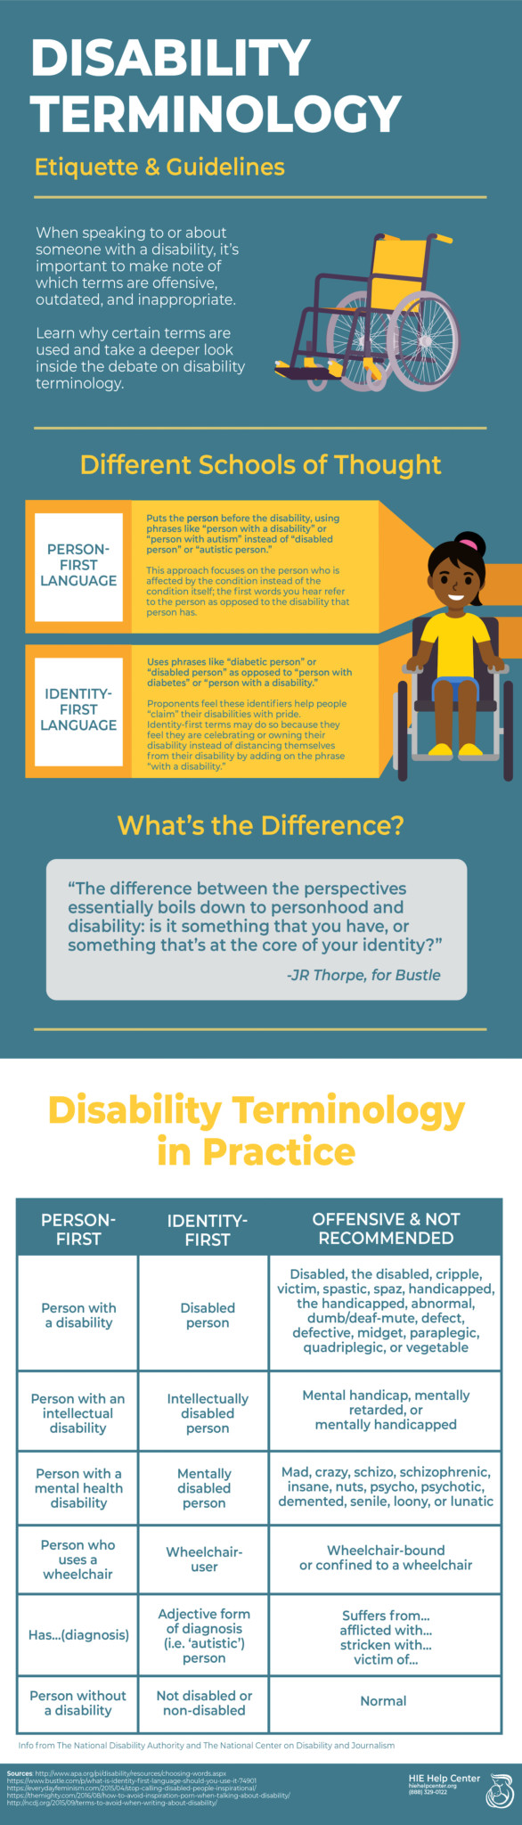
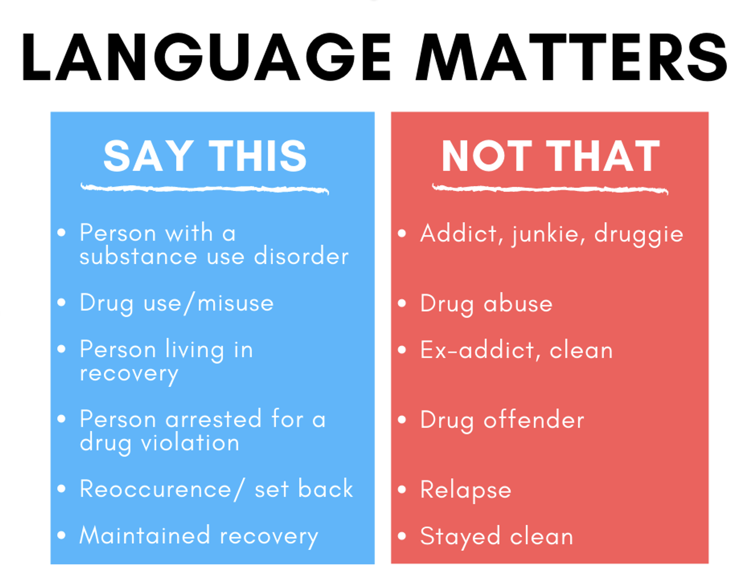
Notes:
You mat not want this, and this may not be needed as the 3rd speaker is a clinician and will bring the clinical/families perspective in

Slide 3

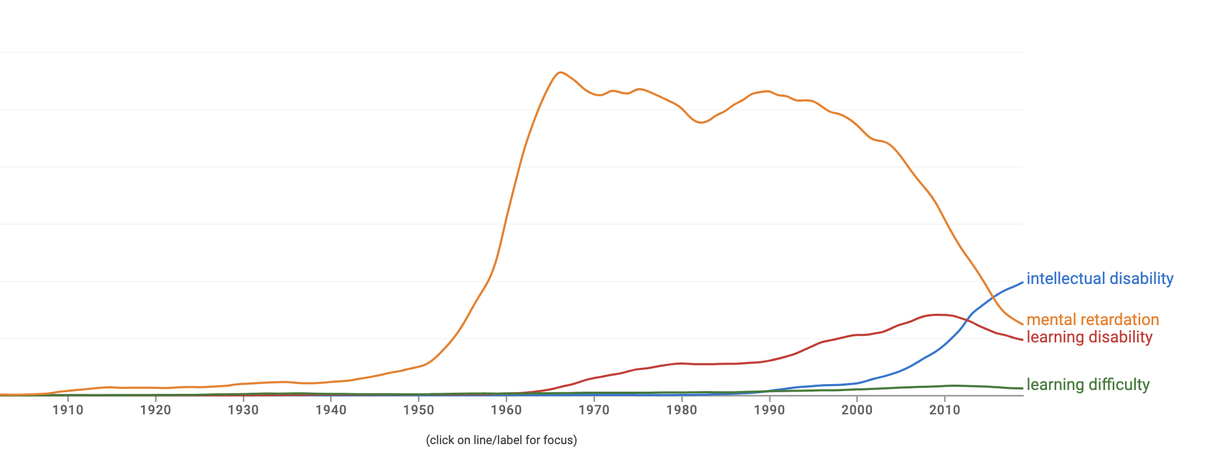
Notes:
Again, not sure if you think this is helpful, only if you want to highligh how languages changes over time

Slide 4
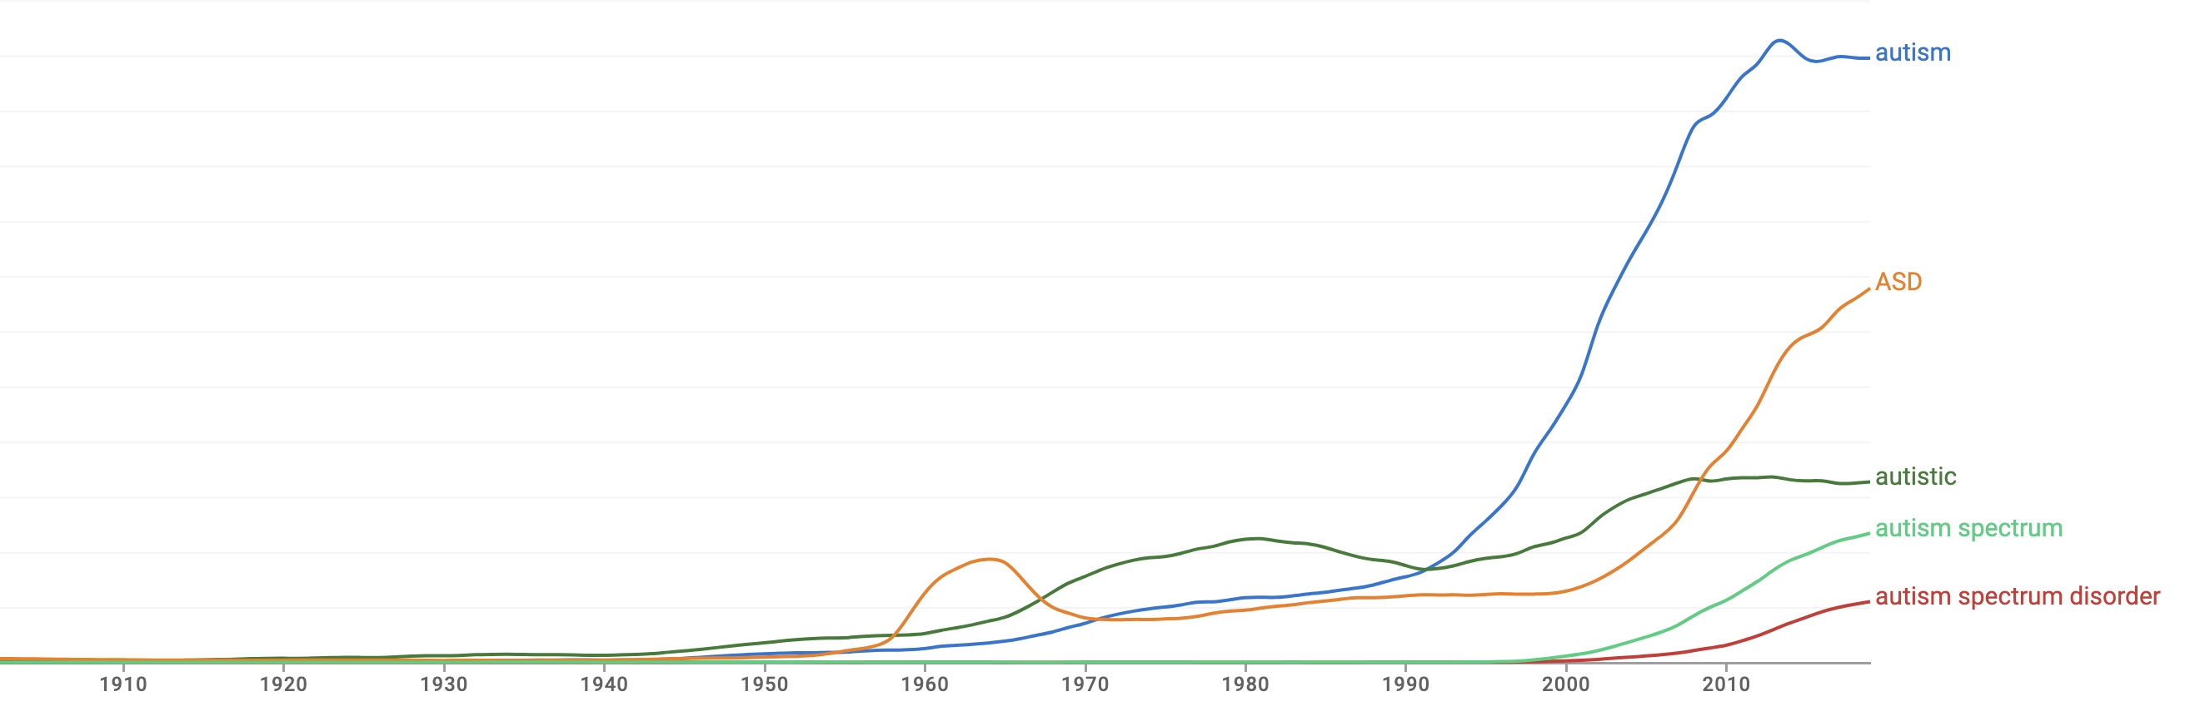

Slide 5
Euphemism treadmill
Process by which euphemisms become negative, pejorative, or taboo

Slide 6
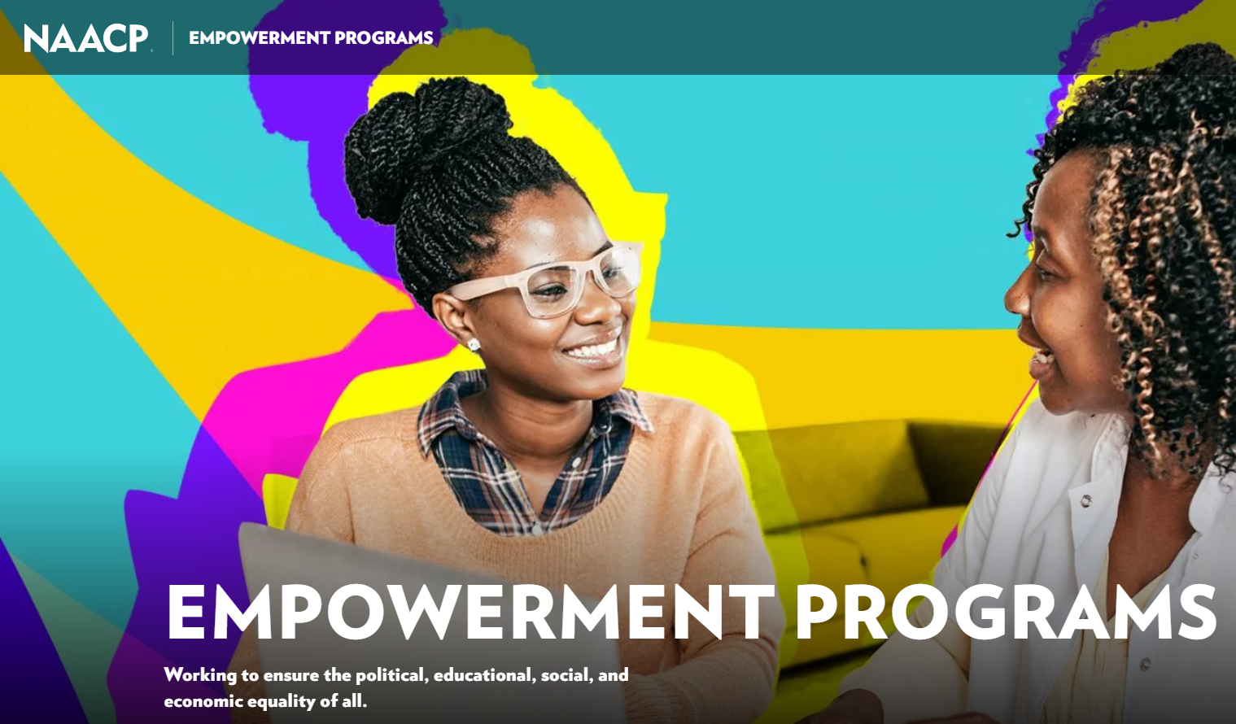
Euphemism treadmill example

Slide 7
Reclaiming euphemisms?
Sometimes people prefer the “offensive” terms
țigan / tzigane
More negative connotations than “roma” but used by some members to refer to themselves without offence
queer
Originally meaning “strange” or “peculiar”, then used as a pejorative, later reclaimed as a deliberatively provocative term

Slide 8
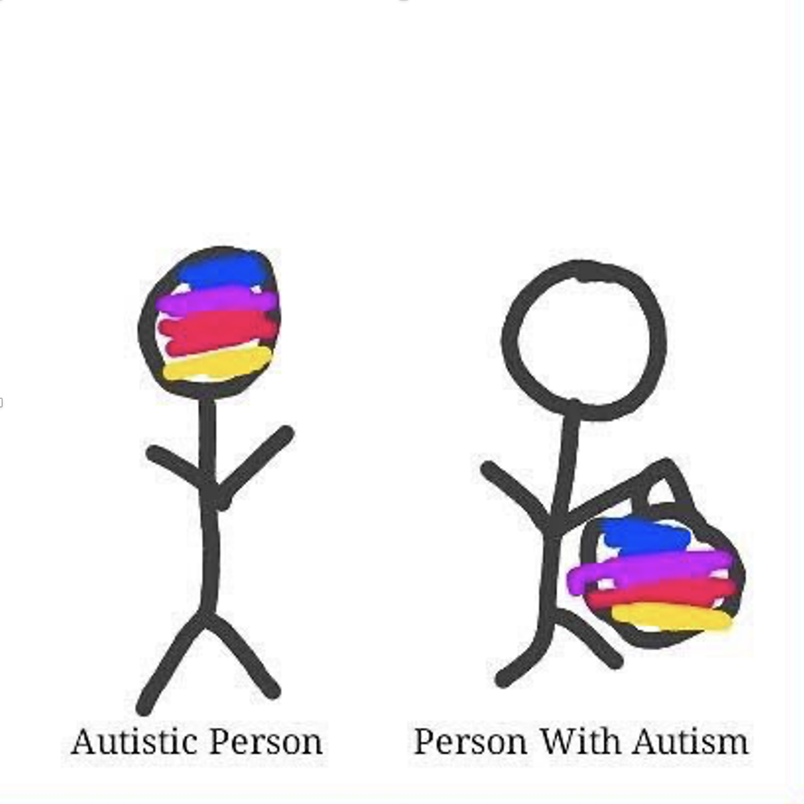
Person-first language
Person-first – “person with autism”, “child with hearing difficulties”, etc.
intends to highlight personhood before diagnosis
meant to avoid dehumanisation, marginalisation, or essentialisation
describes what a person “has” rather than what a person “is”
Notes:
Clearly, there is a problem with 2004.

Slide 9
Identity-first language
Identity-first - “an autistic person”, “a Deaf child”, etc.
some people see these terms as part of their identity/community
doesn’t separate person from adjective or suggest people are “same” with …
social model of disability suggests people “are” disabled by society
Notes:
Clearly, there is a problem with 2004.

Slide 10
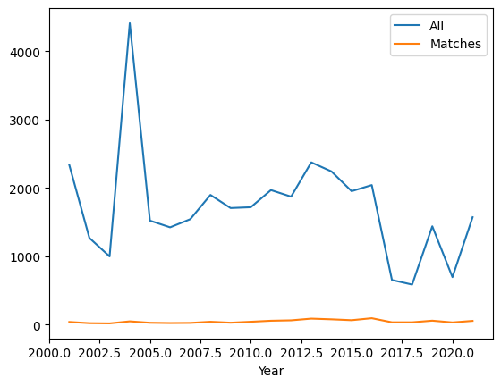
Data = ESHG abstracts
173,955 abstracts in total
1721 with the keywords “autism”, “autistic”, “ASD” or “asperger”
Notes:
Clearly, there is a problem with 2004.

Slide 11
Preparation
31 .pdf files
Acquire original files
Convert .pdf to .txt
All text from .pdf into one line
NLP
Frequency counts
Remove irrelevant pages (cover page, adverts, index, etc.)
Split line by abstract marker
Subset abstracts with keywords 173,995 abstracts -> 1721 abstracts
Examine contexts
Notes:
31 .pdf (some years have 2 files, e.g. one for presentation abstracts and one for poster abstracts)
Semi-manual process to remove irrelevant pages (e.g. remove the indices, cover pages, etc.)
Convert .pdf to .txt files
Split .txt file into abstracts by delimiters 167336
Find all abstracts that contain keywords 1694

Slide 12
NLP Frequency Counts - “bag of words”
Prep
Tokenise words
Lowercase
Remove punctuation
Remove whitespaces
Remove stop words
Consolidate
* Correct spelling
* Substitute synonyms
Stem words
Analyse
Count word frequency
* Not used in the preliminary process

Slide 13
Stemming
A simplistic method of reducing words to a basic form
Collapses nouns and verbs together, as well as singular/plural, first/second/third person, future/present/past tenses, etc.
Examples:
Dog, dogs, and dogged would all reduce to “dog”
Went, going, goes and go would all reduce to “go”

Slide 14
Most common words in abstracts
All abstracts | 'gene' | 'patient' | 'mutat' | 'genet' | 'studi' | 'use' | 'case' | 'result' | 'analysi' | 'associ'
Count | 69245 | 60113 | 57719 | 42684 | 32414 | 28317 | 27007 | 25783 | 24804 | 24741
Matched abstracts | 'patient | 'gene' | 'genet' | 'disord' | 'autism' | 'syndrom' | 'delet' | 'mutat' | 'case' | 'clinic'
Count | 2081 | 1921 | 1235 | 1088 | 1088 | 1087 | 1068 | 984 | 953 | 902

Slide 15
NLP Examine Context - “pattern extraction”
Prep
Tokenise sentences
* Lowercase
* Remove punctuation
* Remove whitespaces
Consolidate
* Correct spelling
* Substitute synonyms
Isolate relevant sentences
Analyse
Extract person-first and identity-first patterns
Manually check for relevance
Count each pattern
Examine each pattern
POS-tag
* Not used in the preliminary process
Notes:
153653 relevant sentences

Slide 16
“Noun with” / person-first pattern
pattern = [{"POS": "NOUN"},
{“LOWER": “with"}
{'DEP':'amod', 'OP':"?"},
{'DEP':'amod', 'OP':"?"},
{'DEP':'amod', 'OP':"?"},
{"TEXT": {"REGEX": “[Au]utism“ or “[Aa]sperger” or “ASD”}}]
Notes:
Identified in this data set include boy with ASD and individual with idiopathic autism,

Slide 17
“Adjective noun” / identity-first pattern
pattern = [{"TEXT": {"REGEX": “[Au]utistic“ or “[Aa]sperger” or “ASD”}},
{'DEP':'amod', 'OP':"?"},
{'DEP':'amod', 'OP':"?"},
{'DEP':'amod', 'OP':"?"},
{"POS": "NOUN"}]
Notes:
Examples from this dataset include: ASD affected sibling and autistic female

Slide 18
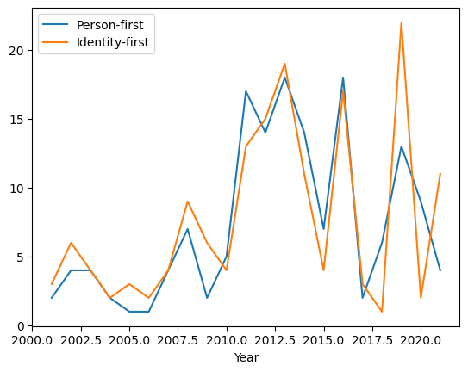
Person-first & Identity-first counts by year

Slide 19
Most common examples of both patterns
156 total person-first structures, 40 are unique
163 total identity-first structures, 31 are unique
patient with autism | 36.0
patient with ASD | 22.0
child with ASD | 13.0
child with autism | 12.0
individual with autism | 12.0
ASD patient | 31.0
autistic patient | 23.0
autistic child | 14.0
autistic individual | 12.0
ASD case | 11.0

Slide 20
169 abstracts >1 patterns, 32 use both
Prevalence of PTEN mutations in Turkish children with autism spectrum disorders and macrocephaly
7 x person-first, 0 x identity-first
Role of serotonin transporter promoter length polymorphism in autism: A south African population based study
0 x person-first, 5 x identity-first
Implicating genetic risk variants for circadian rhythm and sleep trait difficulties in individuals with autism spectrum disorder
5 x person-first, 1 x identity-first
Polymorphism in Serotonin Transporter Gene in Autism
1 x person-first, 5 x identity-first

Slide 21
Future work
Dive into them a bit more, exploring whether the following are factors
- session code as proxy for field/discipline
- affiliation country as proxy for native language of author
- age of person described
- year
- use of adjectives in non-people related contexts
- other?
Notes:
Clearly, there is a problem with 2004.

Slide 22
Who we are:
Professor Ramona Moldovan
University of Manchester, UK
Babeș-Bolyai University, Romania
Ramona.Moldovan@mft.nhs.uk
Dr. J. Kasmire
Cathie Marsh Institute University of Manchester, UK
UK Data Service
J.Kasmire@manchester.ac.uk
@JKasmireComplex
Andrada Ciucă
Babeș-Bolyai University, Romania
andradaciuca@psychology.ro
Notes:
Clearly, there is a problem with 2004.

